Slide 1
YOGURT DAY!
Presentation on Yogurt Forecast Models
Customer Data Analytics
Group 5
HSLU, FS 2021
Notes:
After 4 presentations I guess you know what day it is ... Yes, it’s yogurt day! A warm welcome from group number 5 to the presentation of our yogurt forecast models.

Slide 2
Students (Group 5)
Quyen Duong, E-Mail quyen.duong@stud.hslu.ch
Antonio Folino Ponte, E-Mail antonio.folinoponte@stud.hslu.ch
Urs Hartmann, E-Mail urs.hartmann@stud.hslu.ch
Jeanette Lee, E-Mail jeanette.lee@stud.hslu.ch
Agnes Lei, E-Mail agnes.lei@stud.hslu.ch
Quynh Nhu Casati, E-Mail quynhnhu.nguyenvu@stud.hslu.ch
Nicolas Ott, E-Mail nicolas.ott@stud.hslu.ch
Patricia Wellhöfer, E-Mail patricia.wellhoefer@stud.hslu.ch
Professors
Prof. Dr. Dominik Georgi, E-Mail dominik.georgi@hslu.ch
Dr. Ingo Gächter, E-Mail ingo.gaechter@hslu.ch
Lukas Stolz, E-Mail stolz.lukas@gmail.com
Assignment Due Date: October 20, 2021
Notes:
<<No comment on this slide>>

Slide 3

THE TEAM
DATA SCIENTISTS, BUSINESS ANALYSTS, STATISTICIANS, MACHINE LEARNING SPECIALISTS, VISUALIZERS
Notes:
Our team of data scientists, business analysts, statisticians, machine learning specialists and visualizers spared no effort to dig into forecast models theory, sales figures and slide decks to come up with the best possible solution for your challenge.

Slide 4
—Stephen Colbert
“Don't cry over spilled milk. By this time tomorrow, it'll be free yogurt.”
Notes:
There is no good presentation without a suitable quote, here you go.

Slide 5
TABLE OF CONTENTS
01
02
03
CHALLENGE
ANALYSIS
MODEL
OUR APPROACH
ANALYZED MODELS
CHOSEN MODEL
Notes:
After breaking the ice, let’s get down to business.
To make it easier to follow, we split the presentation into three chapters.
We begin with how we tackled the challenge.
Then we switch over to the quest of forecast models and in the third section we’ll present the most suitable model for the challenge, based on MAPE - of course.

Slide 6
01
THE CHALLENGE
How we tackled the challenge
Notes:
Chapter 1: how we tackled the challenge.

Slide 7
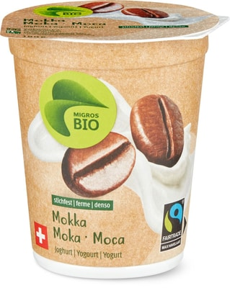
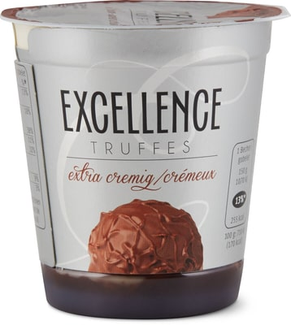
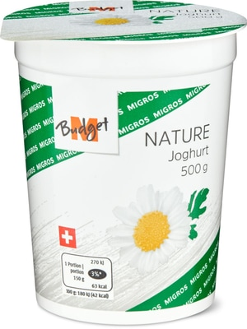
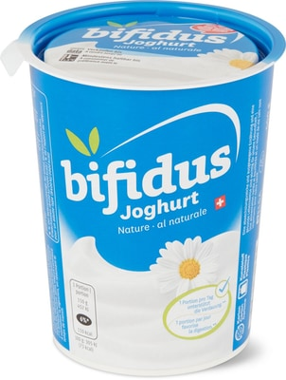
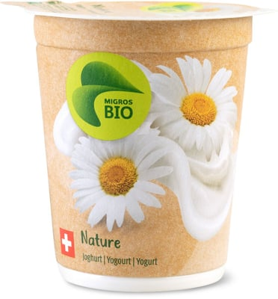
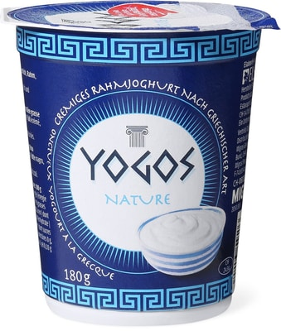
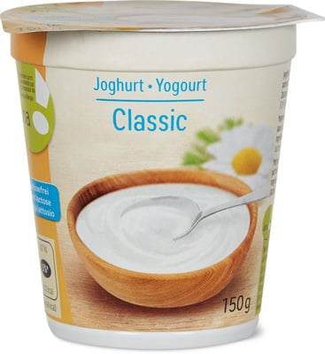
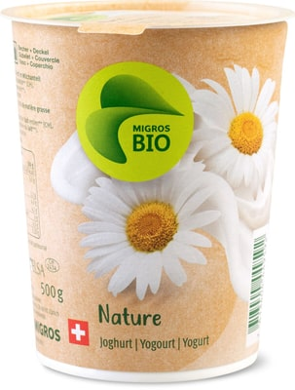
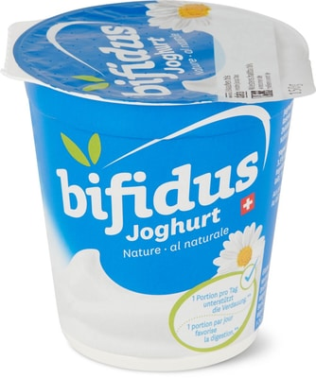
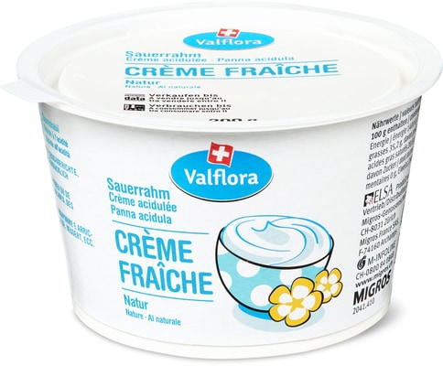
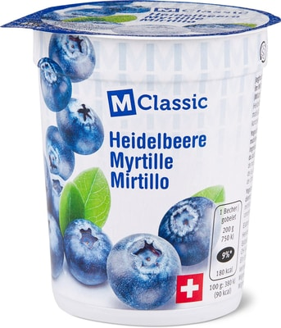
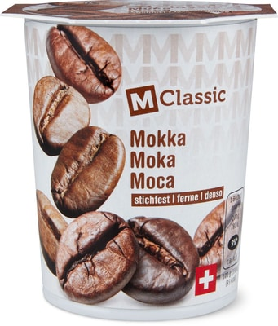

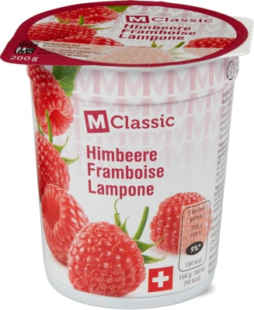
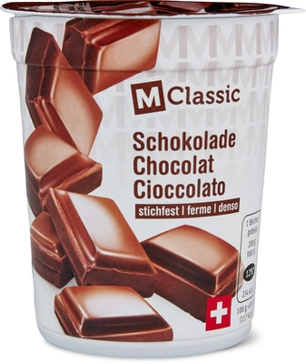
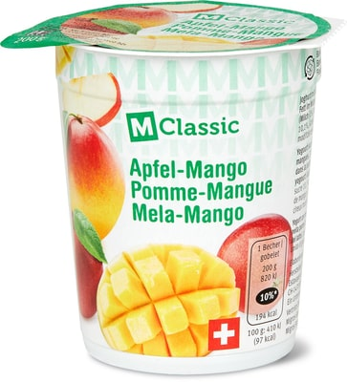
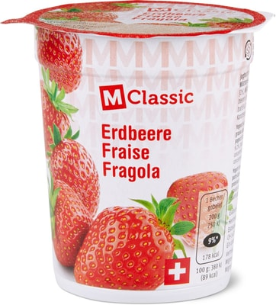
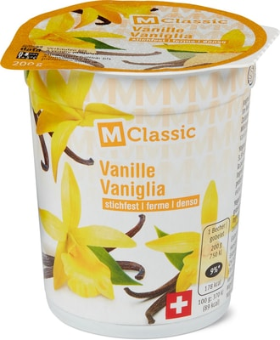
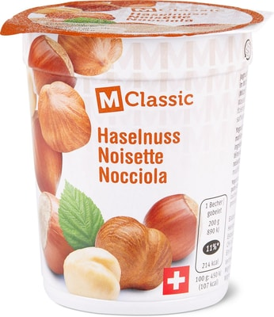
THE ARTICLES
art_0 BIO FAIRT.JOG.MOKKA 180G
art_4 EXC JOGHURT TRUFFES 150G
art_1 MB JOGHURT NATUR 500G
art_2 BIFIDUS JOGH. NATURE 500G
art_3 BIO JOGHURT NATURE 180G
art_5 YOGOS GRECQUE NATURE 180G
art_9 AHA JOGHURT LAKTOSEF CLAS
art_6 BIO JOGHURT NATURE 500G
art_7 BIFIDUS JOGH. NATURE 150G
art_8 VALFLORA CREME FRAICHE NA
art_10 M-CLAS JOG. HEIDELBE 200G
art_14 M-CLAS JOGHURT MOKKA 200G
art_11 M-CLAS JOG. NATURE 200G
art_12 M-CLAS JOG. HIMBEER 200G
art_13 M-CLAS JOG. SCHOKOLA 200G
art_15 M-CLAS JOG. APF/MANG 200G
art_16 M-CLAS JOG. ERDBEER 200G
art_17 M-CLAS JOG. VANILLE 200G
art_18 M-CLAS JOG. HASELNUS 200G
Pictures: https://produkte.migros.ch/
Notes:
To get an overview over the 19 different articles quickly is not easy.
To learn what we are dealing with, we did a little research on the migros website to get familiar with the articles. We then started data exploration by....

Slide 8
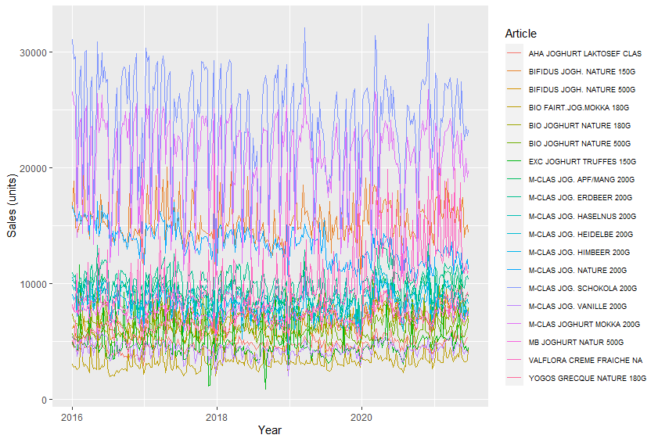
THE SALES
Notes:
.. looking at sales figures. We threw the received data sets into rStudio to compare yogurt sales figures.
We ....

Slide 9
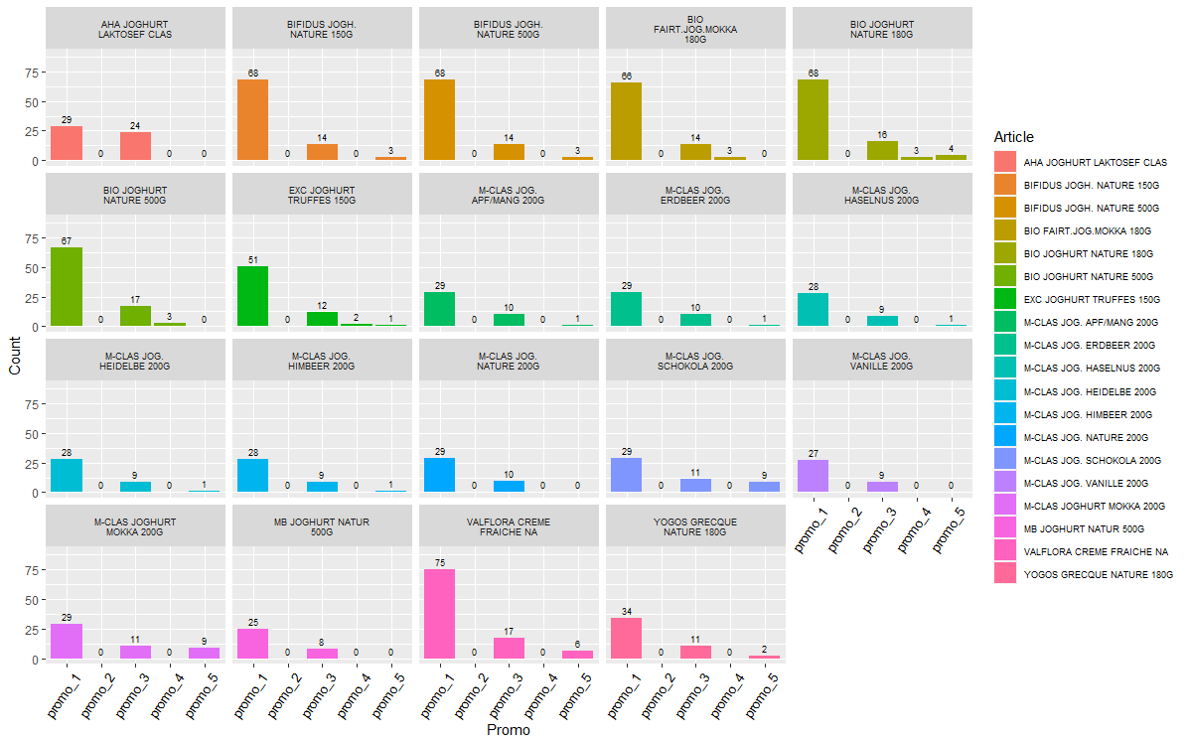
THE PROMOS
PROMO #2 NEVER APPLIED
Notes:
.. also looked at the data set from the standpoint of promotions.
What became visible is that promo number 2 has never been applied in the provided time frame.
Further exploration also showed us that some promotions are run together in the same week(s) for the same product – specifically promo combinations (1 & 3), (1 & 5), (3 & 5), and (1, 3 & 5).
We went further and ..

Slide 10
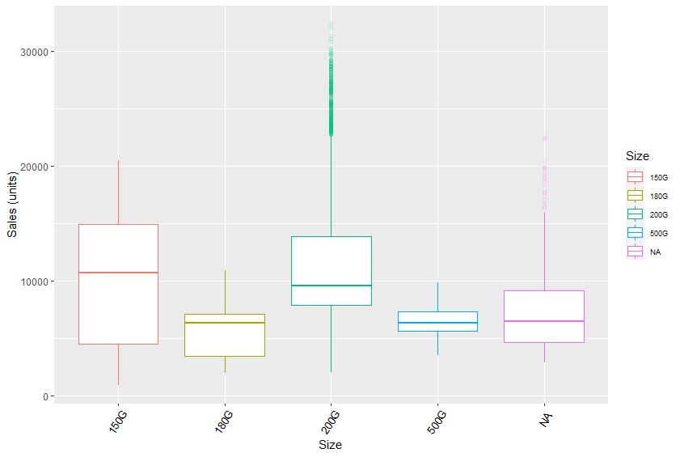
GROUP 1 OF YOGURT TYPES
size | id | article_name
150G | 4 | EXC JOGHURT TRUFFES 150G
150G | 7 | BIFIDUS JOGH. NATURE 150G
180G | 0 | BIO FAIRT.JOG.MOKKA 180G
180G | 3 | BIO JOGHURT NATURE 180G
180G | 5 | YOGOS GRECQUE NATURE 180G
200G | 10 | M-CLAS JOG. HEIDELBE 200G
200G | 11 | M-CLAS JOG. NATURE 200G
200G | 12 | M-CLAS JOG. HIMBEER 200G
200G | 13 | M-CLAS JOG. SCHOKOLA 200G
200G | 14 | M-CLAS JOGHURT MOKKA 200G
200G | 15 | M-CLAS JOG. APF/MANG 200G
200G | 16 | M-CLAS JOG. ERDBEER 200G
200G | 17 | M-CLAS JOG. VANILLE 200G
200G | 18 | M-CLAS JOG. HASELNUS 200G
500G | 1 | MB JOGHURT NATUR 500G
500G | 2 | BIFIDUS JOGH. NATURE 500G
500G | 6 | BIO JOGHURT NATURE 500G
NA | 8 | VALFLORA CREME FRAICHE NA
NA | 9 | AHA JOGHURT LAKTOSEF CLAS
DOES SIZE MATTER?
Notes:
.. started grouping articles by size to see if this has an influence on sales.
Obviously yogurts of size 150 grams and 200 grams sell best. Looks like swiss people either love chocolate or nature yogurt. No shocking insights so far.

Slide 11
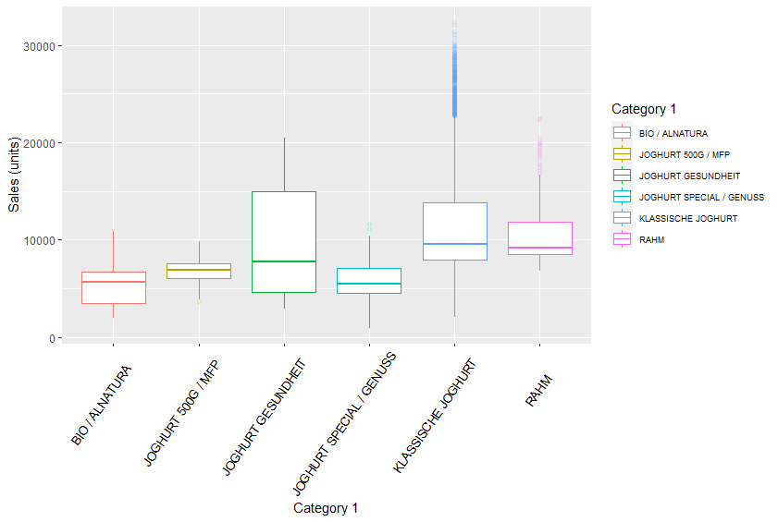
GROUP 2 OF YOGURT TYPES
category | id | article_name
BIO / ALNATURA | 0 | BIO FAIRT.JOG.MOKKA 180G
BIO / ALNATURA | 3 | BIO JOGHURT NATURE 180G
BIO / ALNATURA | 6 | BIO JOGHURT NATURE 500G
JOGHURT 500G / MFP | 1 | MB JOGHURT NATUR 500G
JOGHURT 500G / MFP | 2 | BIFIDUS JOGH. NATURE 500G
JOGHURT GESUNDHEIT | 7 | BIFIDUS JOGH. NATURE 150G
JOGHURT GESUNDHEIT | 9 | AHA JOGHURT LAKTOSEF CLAS
JOGHURT SPECIAL / GENUSS | 4 | EXC JOGHURT TRUFFES 150G
JOGHURT SPECIAL / GENUSS | 5 | YOGOS GRECQUE NATURE 180G
KLASSISCHE JOGHURT | 10 | M-CLAS JOG. HEIDELBE 200G
KLASSISCHE JOGHURT | 11 | M-CLAS JOG. NATURE 200G
KLASSISCHE JOGHURT | 12 | M-CLAS JOG. HIMBEER 200G
KLASSISCHE JOGHURT | 13 | M-CLAS JOG. SCHOKOLA 200G
KLASSISCHE JOGHURT | 14 | M-CLAS JOGHURT MOKKA 200G
KLASSISCHE JOGHURT | 15 | M-CLAS JOG. APF/MANG 200G
KLASSISCHE JOGHURT | 16 | M-CLAS JOG. ERDBEER 200G
KLASSISCHE JOGHURT | 17 | M-CLAS JOG. VANILLE 200G
KLASSISCHE JOGHURT | 18 | M-CLAS JOG. HASELNUS 200G
RAHM | 8 | VALFLORA CREME FRAICHE NA
USEFUL CATEGORIZATION?
Notes:
In a second approach to group articles we used migros’ own labeling. We see here that there does seem to be a difference, however further analysis was needed to determine whether it is useful in predicting sales.
We also did a visual analysis of a number of other variables, however due to limited time today, we have included these in the appendix for reference.

Slide 12
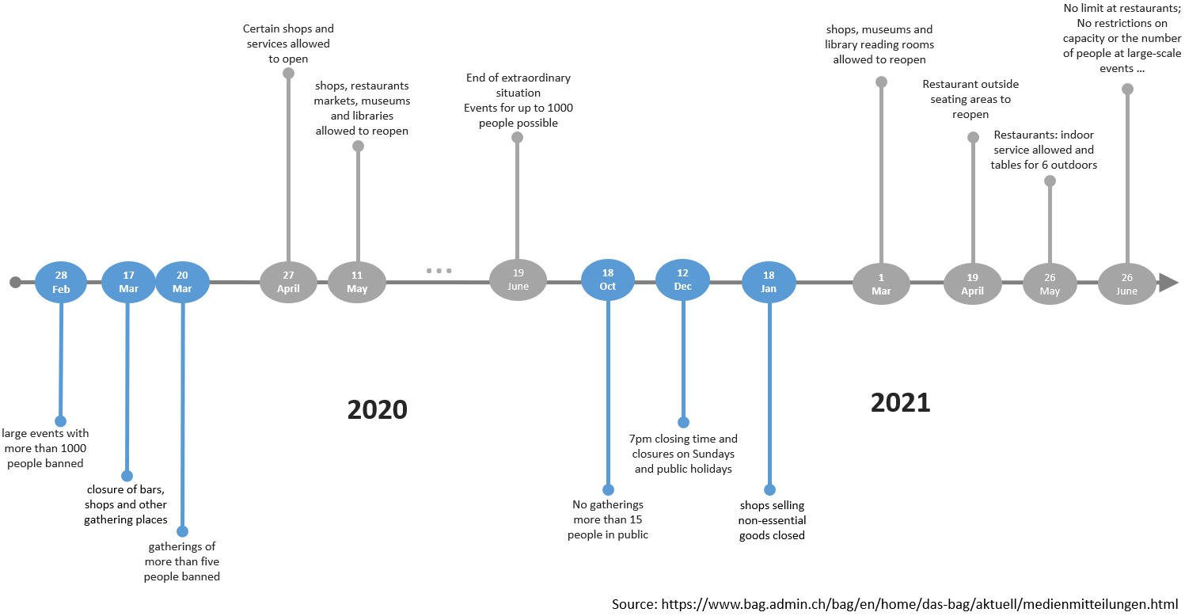
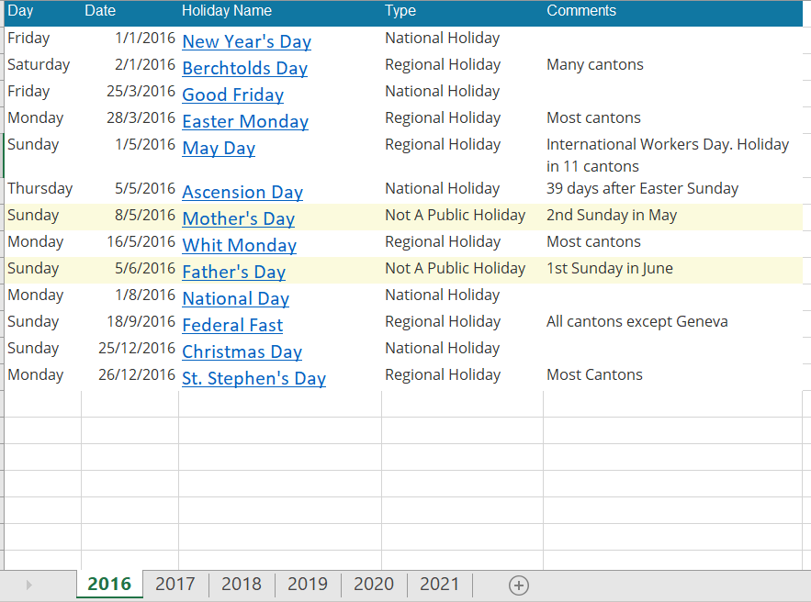
Additional Data
COVID Restrictions
National Holiday
Source: https://www.officeholidays.com/countries/switzerland/zurich/2020
Notes:
Leaving the world of Migros we went on a journey to find additional data sets that could be merged with original sales data.
On our journey we found data on COVID restrictions and National Holidays. Our goal was to find any interaction of Covid restrictions or National Holidays with the yogurt sales.
Regarding COVID there is no clear definition of lockdowns as we have always been able to move freely within Switzerland. But there are different levels of restrictions regarding the opening of shops and restaurants, the group size of gatherings etc. Therefore two dummy variables «covid_restrictions_added» and «covid_restrictions_reduced» were created.
For holidays we took national holidays rather than cantonal level.
So what did we do next?
We started to experiment on our own:

Slide 13
THE EXPERIMENTATION
1
2
5 Promos
3
1 Cup Forecast Models
19 Articles
5
Bad Yogurt
4
rStudio
Notes:
We took given 19 articles,
added 5 promos,
poured in 1 cup of forecast models,
stirred it for a while in R - and what came out?
Bad yogurt!

Slide 14
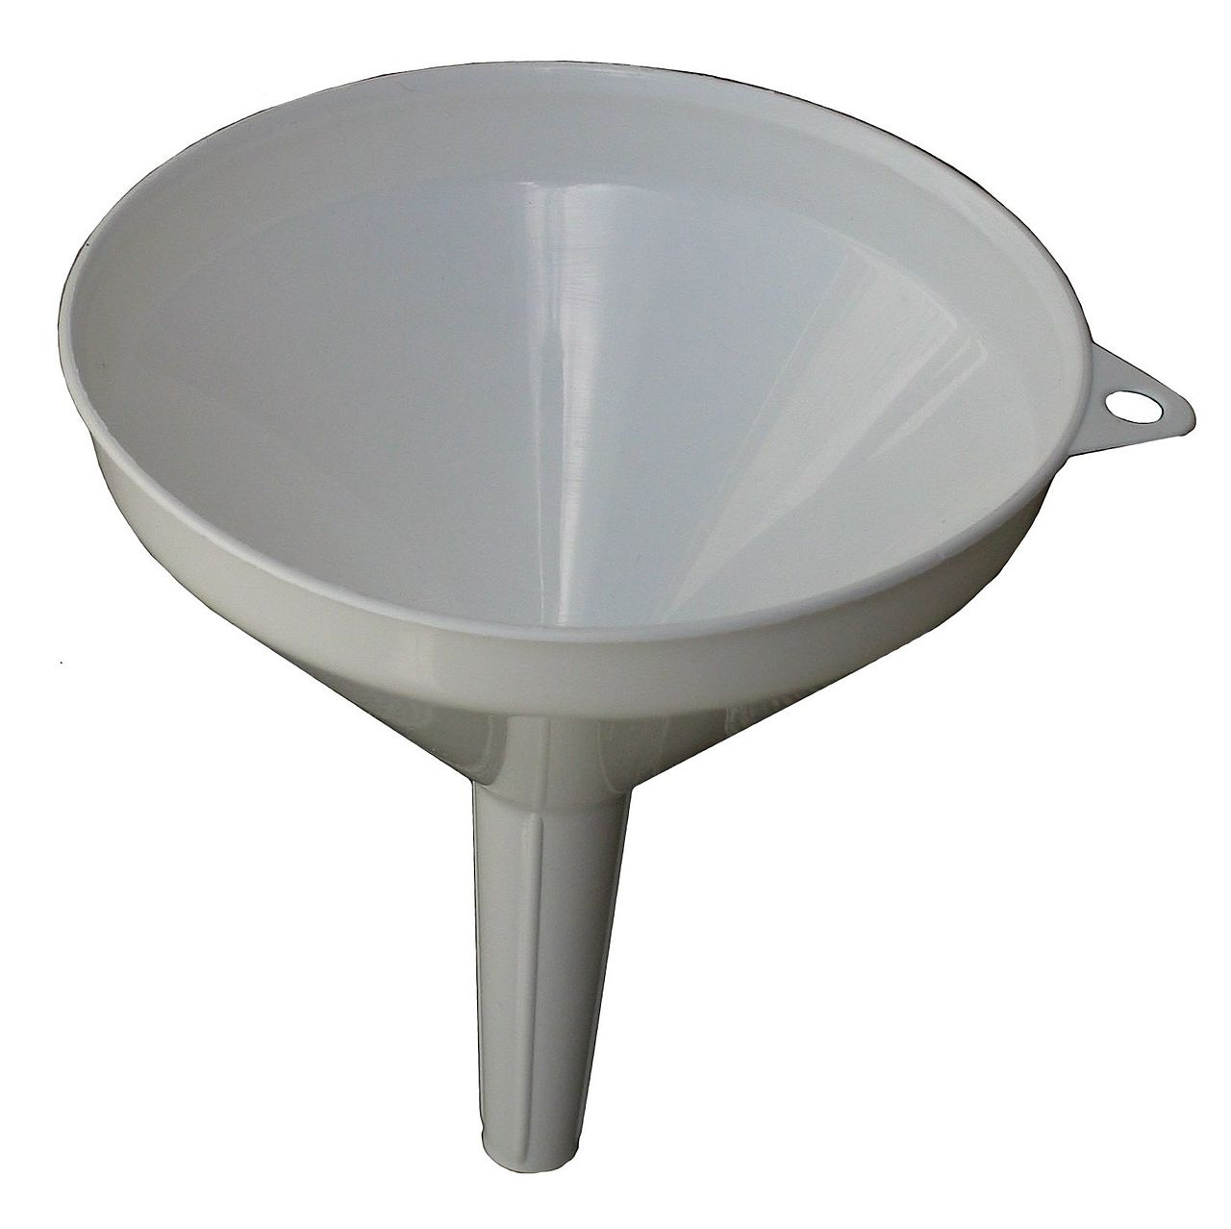
THE CONSOLIDATION
XGBOOST
GAM
RANDOM FOREST
LM
AUTO ARIMA
SARIMA
AUTO ARIMA
LM
RANDOM FOREST
GAM
Picture: https://upload.wikimedia.org/wikipedia/commons/thumb/1/11/Kitchen_Funnel.jpg/1280px-Kitchen_Funnel.jpg
Notes:
We experimented further, read theory, tried XGBOOST, GAM, AUTO ARIMA, SARIMA, LM and RANDOM FOREST as forecast models. Not all of them made it through the funnel.
As quality reference we always used the MAPE indicator.

Slide 15
02
ANALYSIS
What came out of the funnel?
Notes:
So, what came out of the funnel?

Slide 16
AWESOME YOGURT!
Notes:
AWESOME YOGURT!

Slide 17
4 MODELS OF FORECASTING
LM
AUTO ARIMA
GAM
RANDOM FOREST
Notes:
In this second chapter we dig a little deeper into the 4 models we elected to work further with. For your convenience, the setup of the slides for each model will approximately be the same.
Lets start with the LM model:

Slide 18
LM (Linear Model)
What is LM?
A linear regression is a statistical model that analyzes the relationship between a response variable (often called y) and one or more variables and their interactions (often called x or explanatory variables)¹.
When to use?
When the relationship between the independent and dependent variables is linear.
¹ Source: https://en.wikipedia.org/wiki/Linear_model
Notes:
The linear model or short LM analyses the relationship between a response variable and one or more variables and their interactions.
The model is used when the relationship between the independent and dependent variables is linear.

Slide 19
PROs & CONS: LM
PROs
CONs
Simple to implement
Easier to interpret the output coefficients
Less complexity
Only looks at linear relationships and assumes there is a straight-line relationship
Only looks at the mean of the dependent variable
Not a complete description of relationships among variables
Sensitive to outliers
Assumes that data is independent
Notes:
Pros of the LM model: it is simple and easy to implement and interpret.
Cons: there are too many assumption on linear relationship and independence. Plus, it is sensitive to outliers.

Slide 20
Modelling with LM
Splitting up the data set into test and training
Tried out different time frames
Transformations
Used log-transformed sales
Selection of variables
Existing variable set: time, promos
Set up variables for covid restrictions and holidays
Finding the right variables: Tried different combinations of the variables to find out the one that results in the lowest MAPE
Final model
logSales ~ week + covid_restriction_added + covid_restriction_reduced +article_name * month *holidays * promo_01*promo_03*promo_05
Notes:
When modelling with LM we had to try out different combinations of variables.
Since we couldn’t find a systematic way to test the interactions between the variables, we had to do the manually by trying out different combinations.
At the end, the combination which produces the lowest MAPE was chosen.

Slide 21
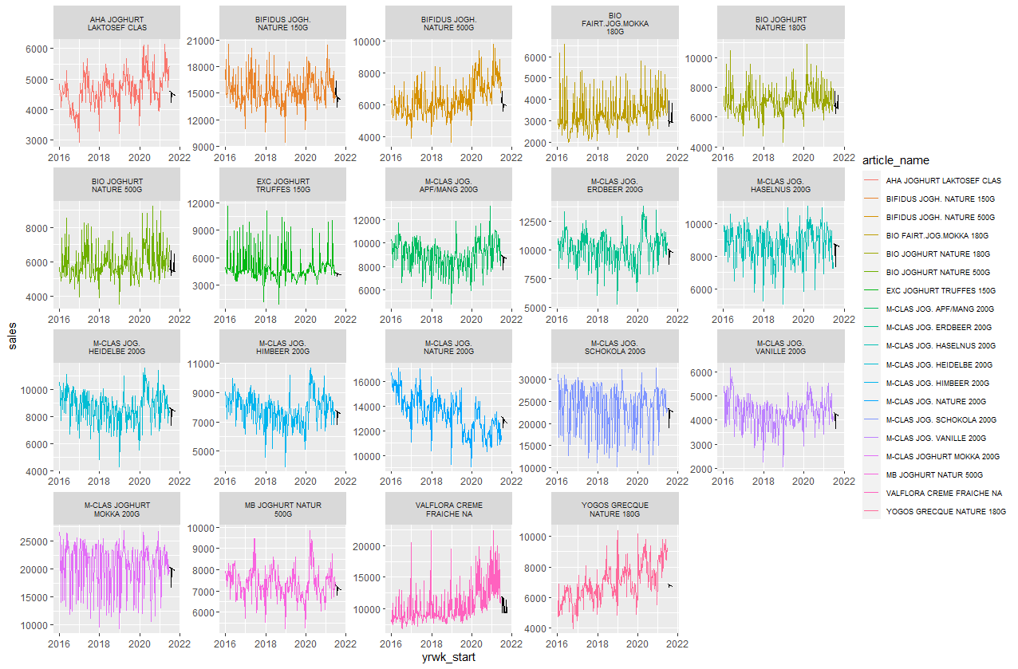
LM
Notes:
And here are the plotted results for LM.

Slide 22
12,61%
MAPE for model LM
Notes:
By using the LM model we reached a MAPE of 12.61%.
We can do better!

Slide 23
4 MODELS OF FORECASTING
LM
AUTO ARIMA
GAM
RANDOM FOREST
Notes:
.. «Random Forest».

Slide 24
RANDOM FOREST
What is Random Forest?
Random forests or random decision forests are an ensemble learning method for classification, regression and other tasks that operates by constructing a multitude of decision trees at training time¹.
When to use?
When working with a large dataset.
When interpretability is not a major concern.
When working with multiclass problems.
¹ Source: https://en.wikipedia.org/wiki/Random_forest
Notes:
Random forest is an combined learning method for classification, regression and other tasks that operate by constructing a multitude of decision trees at training time.
When to use?
When working with a large dataset.
When interpretability is not a major concern.
When working with multiclass problems.

Slide 25
PROs & CONS: RANDOM FOREST
PROs
CONs
Powerful tool for large data sets​
Performs both regression & classification tasks​ & presents estimates for variable importance, i.e., neural nets​
Offers a superior method for working with missing data​ & provides the highest accuracy in classification​
Accurate predictions on highly non-linear data​
Handles the over-fitting problem well
Hard to interpret​
Requires much computational power & resources
Many trees can make the algorithm too slow & ineffective for real-time predictions
Not suitable for linear methods with a lot of sparse features​
Found to be biased while dealing with categorical variables
Notes:
Looking at the pros of random forest:
It is a powerful tool for large data sets​ and handles the over-fitting problem well.
Looking at the cons of random forest:
It can be hard to interpret.
Many trees can make the algorithm too slow and ineffective for real-time predictions.

Slide 26
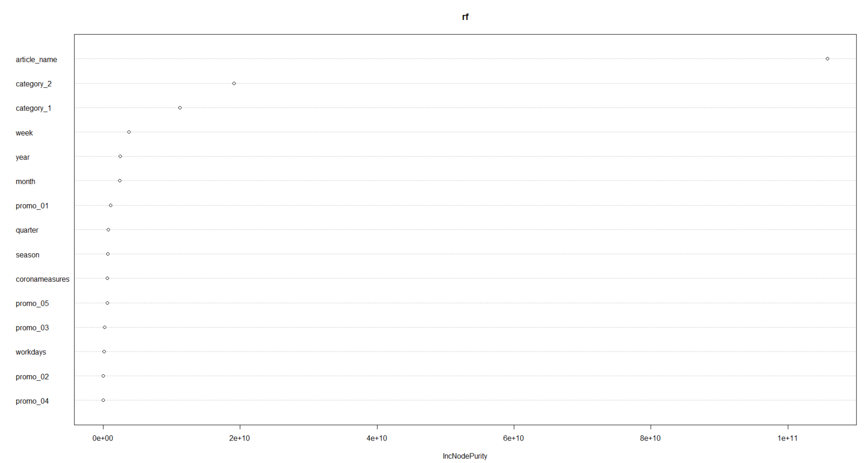
Modelling with Random Forest
Additional information:
National holidays
Four seasons
Corona pandemic
Partitioning:
train = 2016 to 2020 / test = 6 months of 2021
MAPE with checking for over-fitting:
10.21%
Checking importance of independent variables:
Final Model : sales ~ article_name + category_2 + category_1 + week + year + month + promo_01 MAPE: 11.32%
Notes:
Now how did the modelling with random forest go? Just to play with the data, all variables were thrown in (national holidays, all seasons, covid data). With that we achieved a MAPE of 10.21%. But within that there is no over-fitting check. So, we digged deeper. We checked importance of independent variables and cutted out the ones not important for the model.
By doing so MAPE increased slightly to 11.32% - but with less variables and less overfitting.
So for our challenge here we would go with the 10.21% but in real life we would suggest going with 11.32% and less over-fitting (and better calculating performance).
The challenges we faced with Random Forest were:
How to decide which variables to take?
And at what values is over-fitting a problem?

Slide 27
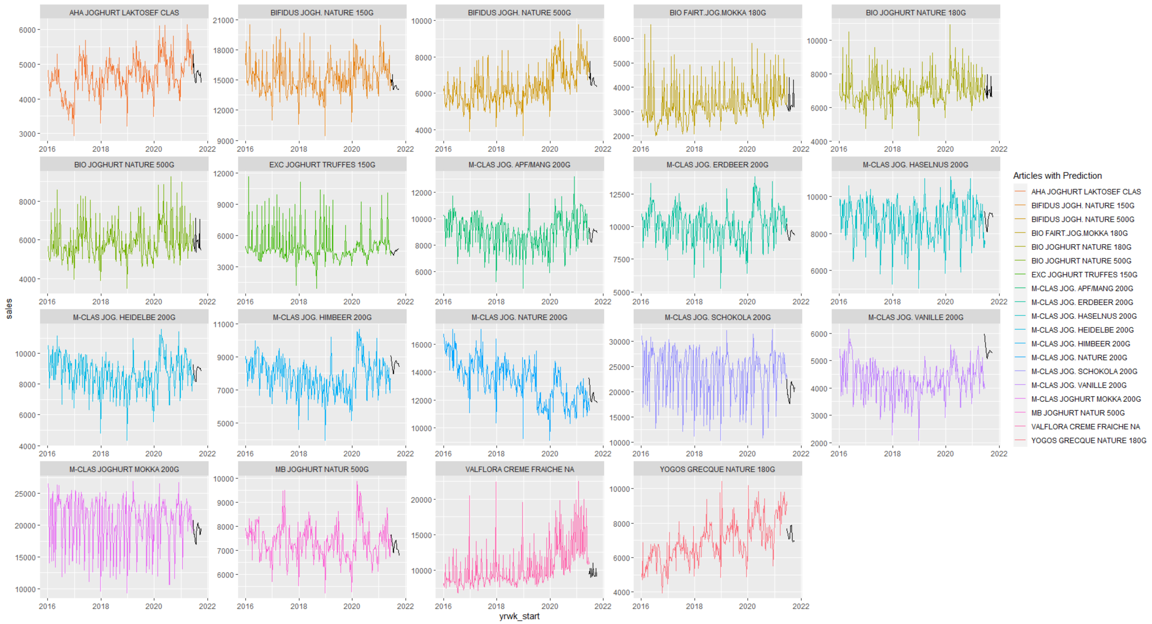
RANDOM FOREST
Notes:
What you are looking at right now are the forecast graphs for the random forest model with less variables (over-fitting is reduced). As already mentioned, overall we reached ...

Slide 28
10,21%
MAPE for model Random Forest
Notes:
.. acceptable 10.21% with that model. Unbeatable you think?

Slide 29
February 6th
is National Frozen Yogurt Day in the U.S.
Notes:
Did you know? February 6th is national frozen yogurt day in the US!
But let’s continue with our 3rd model ....

Slide 30
4 MODELS OF FORECASTING
LM
AUTO ARIMA
GAM
RANDOM FOREST
Notes:
The third model we look at is the GAM model.

Slide 31
GAM (Generalized Additive Model)
What is GAM?
GAM is an extension of the linear model
With GAM you can also model non-linear data
To do that, you use functions instead of coefficients for the predictor variables
When to use?
When we need an interpretable model for non-linear data
¹ Source: https://en.wikipedia.org/wiki/Generalized_additive_model
Notes:
GAM is an extension of generalized linear models in which the linear response variable depends linearly on unknown smooth functions of some predictor variables.
Interest focuses on inference of these smooth functions¹.
GAMs relax the restriction that the relationship must be a simple weighted sum. Instead, it assumes that the outcome can be modelled by a sum of arbitrary (polynomial) functions of each feature.

Slide 32
PROs & CONS: GAM
PROs
CONs
GAMs relax the assumption of a linear relationship and are therefore much more flexible
GAMs remain easy to interpret
More complex than LMs
Higher risk of overfitting
Notes:
Looking at the advantages of GAM:
GAMs relax the assumption of a linear relationship and are therefore much more flexible.
Although GAMs remain easy to interpret.
Disadvanatges:
The model will lose predictability when the smoothed variables have values outside of the range of a training dataset.
Users of the GAM model sacrifice predictability outside of the data range for precision within the data range.

Slide 33
Modelling with GAM
Splitting up the data set into test and training
Tried out different time frames
Transformations
Tried out with log-transformed sales
Selection of variables
Existing variable set: time, promos, categories
Set up new categories according to names («big», «mclas», «bio»)
Set up variables for covid restrictions and holidays
Finding the right variables: Trial and error
Final model
sales ~ year + month + week + promo_01 + promo_02 + promo_03 + promo_04 + promo_05
Notes:
The way of modelling GAM was pretty similar to the modelling of LM: different time frames, log-transformed sales, adding variables.
But in the end, and this is also how we got the best MAPE was simply by trial and error.
The challenges and questions we faced with GAM were:
How to find the right variables systematically?
How to optimize parameters in GAM?
(next slide)
BACKUP:
How to split up the data set in test and training (also tried with log-transformed sales) Tried different time horizons: train = 2016 to 2018 / test = 3 and 6 months of 2019 train = 2016 to 2019 / test = 3 and 6 months of 2020 train = 2016 to 2020 / test = 3 and 6 months of 2021
What variables to use? Tried different combinations of variables: sales ~ year + month + week sales ~ promo_01 + promo_02 + promo_03 + promo_04 + promo_05 sales ~ year + month + week + promo_01 + promo_03 + promo_04 + promo_05 sales ~ year + month + week + promo_01 + promo_02 + promo_03 + promo_04 + promo_05 sales ~ year + month + week + promo_01 + promo_02 + promo_03 + promo_04 + promo_05 + category_1 sales ~ year + month + week + promo_01 + promo_02 + promo_03 + promo_04 + promo_05 + category_2 sales ~ year + month + week + promo_01 + promo_02 + promo_03 + promo_04 + promo_05 + category_1 + category_2 Setting up new variables «big», «mclas», «bio» due to name: sales ~ year + month + week + promo_01 + promo_02 + promo_03 + promo_04 + promo_05 + big + mclas + bio sales ~ year + month + week + promo_01 + promo_02 + promo_03 + promo_04 + promo_05 + holidays sales ~ year + month + week + promo_01 + promo_02 + promo_03 + promo_04 + promo_05 + covid_restrictions sales ~ year + month + week + promo_01 + promo_02 + promo_03 + promo_04 + promo_05 + holidays + covid_restrictions
MAPE: for sales ~ year + month + week + promo_01 + promo_02 + promo_03 + promo_04 + promo_05 and train = 2016 to 2020 / test = 6 months of 2021 => 0.08430414

Slide 34
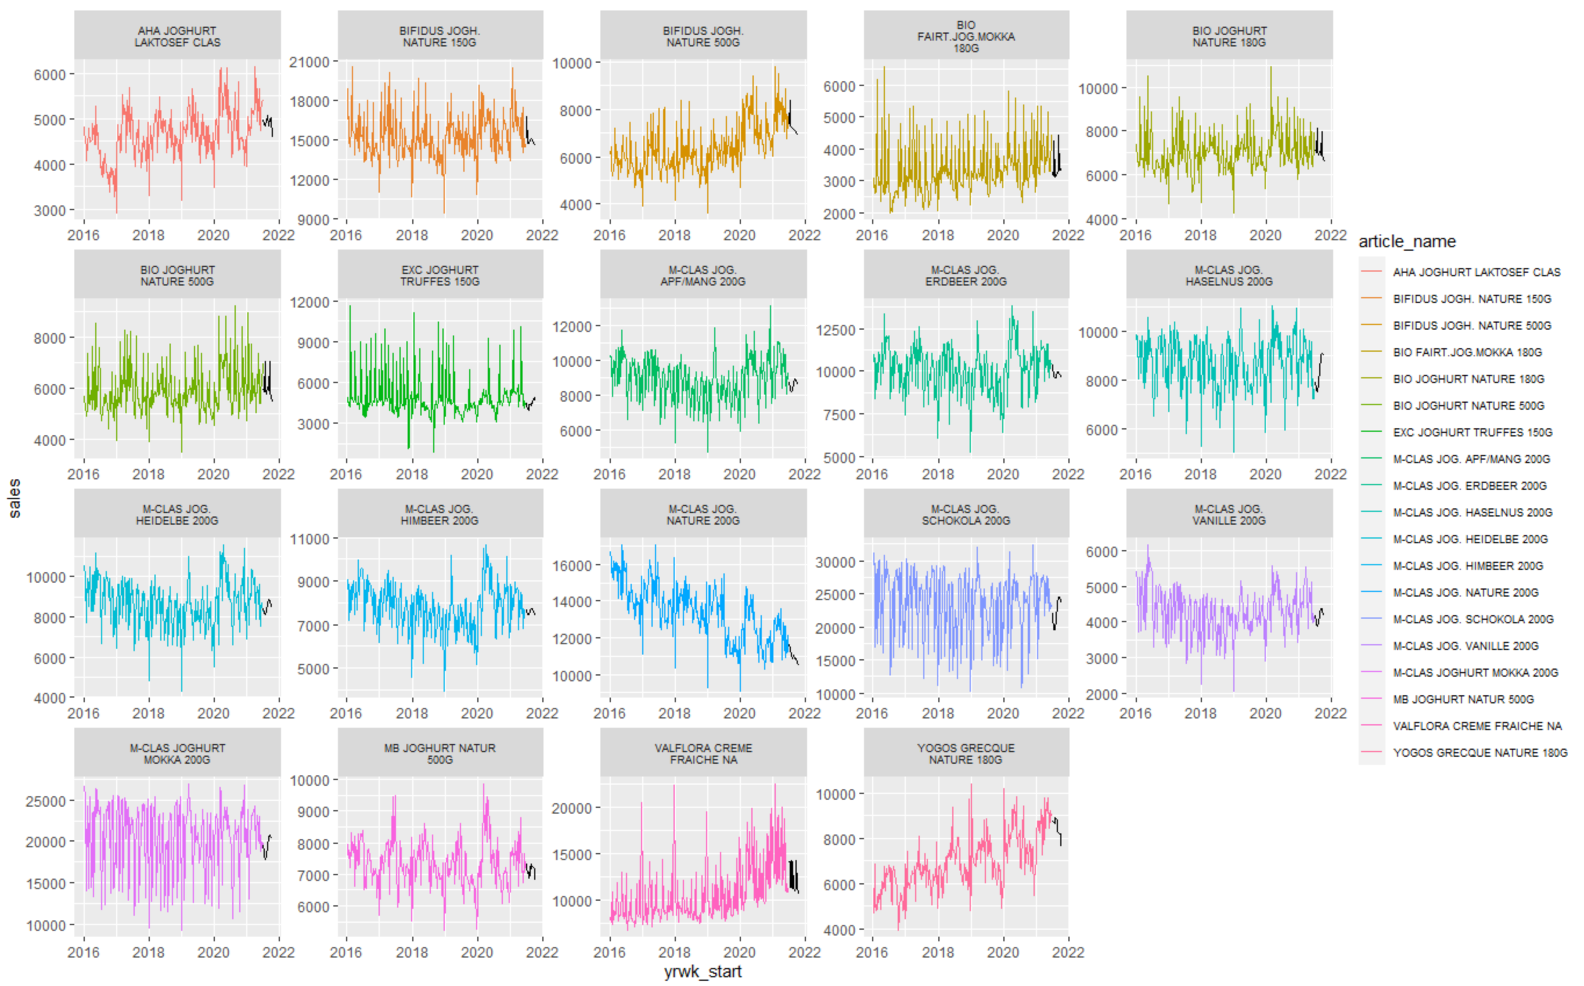
GAM
Notes:
Voilà, the plotted results for GAM.

Slide 35
8,43%
MAPE for model GAM
Notes:
By using the GAM model we reached a MAPE of 8.43%.
See, we got better! Is this the peak already? Let’s check the fourth and last model ...

Slide 36
4 MODELS OF FORECASTING
LM
AUTO ARIMA
GAM
RANDOM FOREST
Notes:
... Auto Arima!

Slide 37
AUTO ARIMA
What is Auto Arima?
A linear regression is a statistical model that analyzes the relationship between a response variable (often called y) and one or more variables and their interactions (often called x or explanatory variables)¹.
Instead of choosing manually, it automates the selection of (p, d, q) coordinates (p = autoregressive, d= # of differences, q = moving average)
Auto ARIMA takes the AIC & BIC values generated to determine the best combination of parameters
When to use?
When metrics are recorded in regular intervals (daily, weekly or monthly periods).
When working with a long historical horizon.
When you deal with the time series itself without other features.
When working with non-stationarity data.
¹ Source: https://www.investopedia.com/terms/a/autoregressive-integrated-moving-average-arima.asp
Notes:
ARIMA stands for Auto Regressive (AR) Integrated (I) Moving Average (MA).
In contrast to the LM model, Auto Arima selects coordinates p for autoregressive, d for differences and q for the moving average automatically.
Also, Auto ARIMA takes the AIC (Akaike Information Criterion) and the BIC (Bayesian Information Criterion) values to determine the best combination of parameters.
When to use?
When metrics are recorded in regular intervals (daily, weekly or monthly periods).
When working with a long historical horizon.
When you deal with the time series itself without other features.
When working with non-stationarity data.

Slide 38
PROs & CONS: AUTO ARIMA
PROs
CONs
A powerful & effective time series technique​
Widely used in technical analysis to forecast future prices​
Requires data on the time series only (univariate models)
Using Auto ARIMA instead of the ARIMA: after the data pre-processing step the steps can be skipped and directly fit in the model
Implicitly assuming that the future will resemble the past
Long term forecast eventually goes to be straight line and poor at predicting series with turning points​
Cannot exploit other explanatory features
Notes:
When it comes to pros of auto arima:
It is a powerful and effective time series technique.
When it comes to cons of auto arima:
The model implicitly assumes that the future will resemble the past.
And the model cannot exploit other explanatory features.

Slide 39
Modelling with AUTO ARIMA
Splitting up the data set into test and training
Tried out different time frames
Selection of variables
Sales over the time.
Final model
sales ~ sales
Notes:
Modelling with Auto Arima seems pretty easy, right?
MAPE calculation:
train = 2016 to 2020 / test = 6 months of 2021 => 0.109235

Slide 40
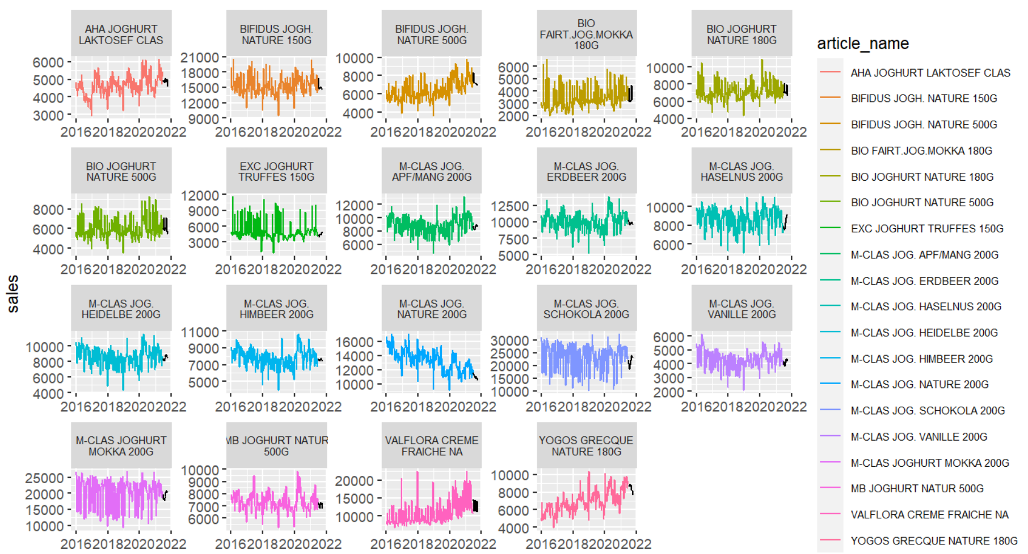
AUTO ARIMA MODEL
Notes:
.... and here you can see the outcome of Auto Arima.
What we all are waiting for now is the final MAPE number. How did Auto Arima perform regarding MAPE? Let‘s solve the mystery.

Slide 41
10,09%
MAPE for model Auto Arima
Notes:
... 10.09% for Auto Arima! Not too bad I’d say. However, ...

Slide 42
03
THE MODEL CHOSEN
Presentation of results
Notes:
... the model chosen from our group is ...

Slide 43

THE WINNER
GAM
8,43%
AUTO ARIMA
GAM
10,09%
LM
RANDOM FOREST
12,61%
10,21%
Notes:
.. GAM! *APPLAUSE*
The 8.43% is the peak, we couldn’t bring it further down. With GAM as our winner …

Slide 44




REFLECTIONS
Dealing with problems
Practical implications
Potential discussions for further analysis
Notes:
…. it is time now to reflect on the task itself. What were the real challenges, learnings and take-aways?
Regarding Project Problems we were challenged with
Limited time and experience towards machine learning modules.
And we also struggled with Identifying potential independent variables and getting access to additional data.
Regarding Practical Implications we found it
Difficult to measure and incorporate ongoing factors into a model (e.g. covid).
Also, one can only include so many factors into a model before it becomes unwieldy or overfit.
For a Further Analysis we would look into:
Incorporating additional data sets for a more robust prediction model (e.g. considering substitute or parallel products – other breakfast foods).
We would combine prediction models (i.e. articles that have similar trend lines) to create models with better fit.
We would create confidence intervals to improve predictions based on multiple models.
Having that said …

Slide 45
THANKS FOR LISTENING!
Do you have any questions?
Notes:
... we reached the end of our presentation. Thank you for listening!
We are happy to answer your questions now.

Slide 46
WHY SHOULD YOU EAT YOGURT?
Just in case you did not know, there are 7 benefits in yogurt that lift your health.
rich in important nutrients
high in protein
contain live bacteria (probiotics) (only some yogurts)
strengthen your immune system
may protect against osteoporosis
may benefit heart health
may promote weight management
However, make sure to choose your yogurt wisely. For maximal health benefits, choose plain, unsweetened varieties that contain probiotics.
Facts: https://www.healthline.com/nutrition/7-benefits-of-yogurt# Picture: https://produkte.migros.ch/excellence-truffes-joghurt-mit-rahm
Notes:
<<Slide to be shown when discussion is ongoing>>

Slide 47
APPENDIX / BACKUP

Slide 48
THE APPROACH
DATA EXPLORATION
USING MIGROS VARIABLES
CONSOLIDATION
EXPERIMENTATION
Pictures: https://produkte.migros.ch/

Slide 49
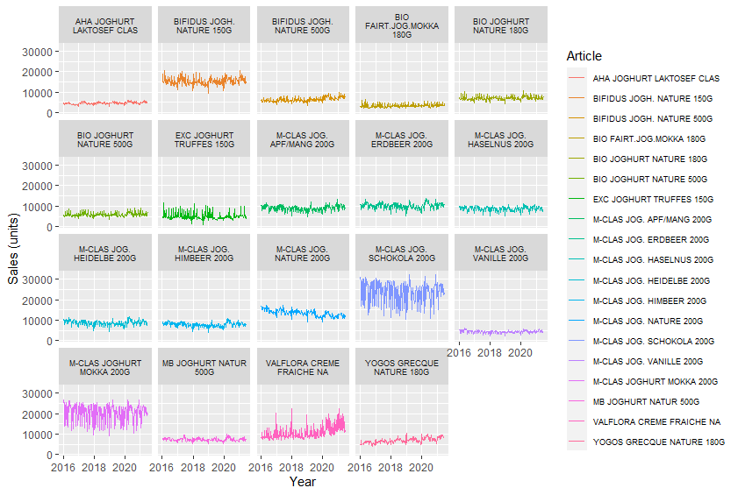
SALES

Slide 50
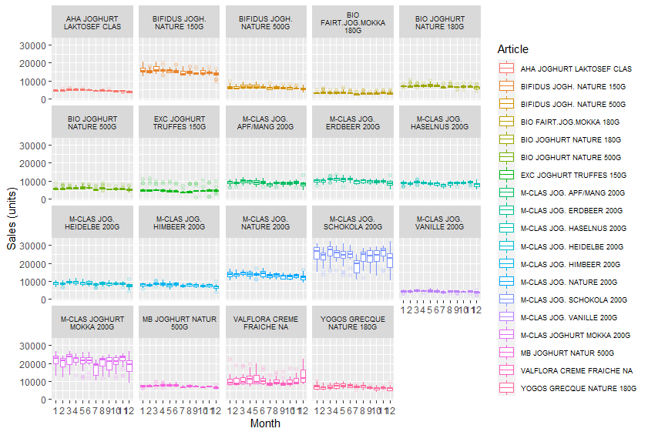
SEASONALITY

Slide 51
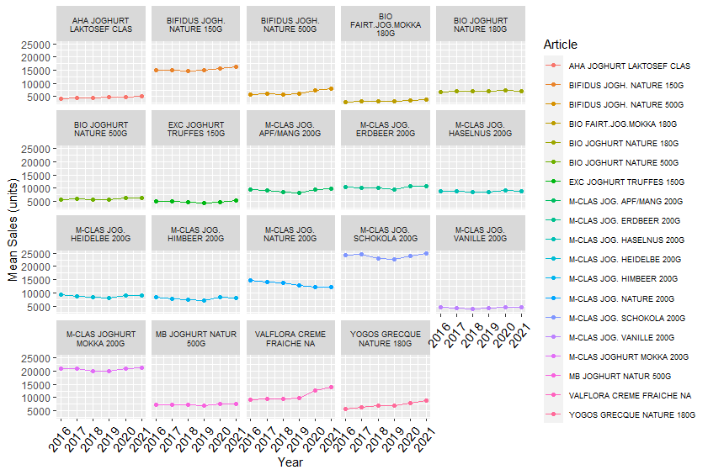
Y-o-Y GROWTH

Slide 52
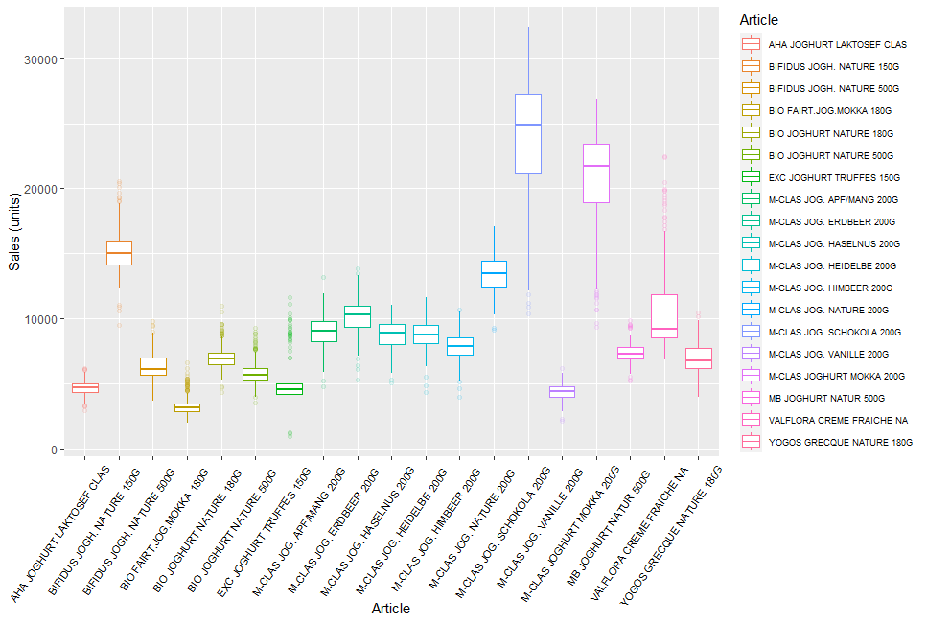
ARTICLES

Slide 53
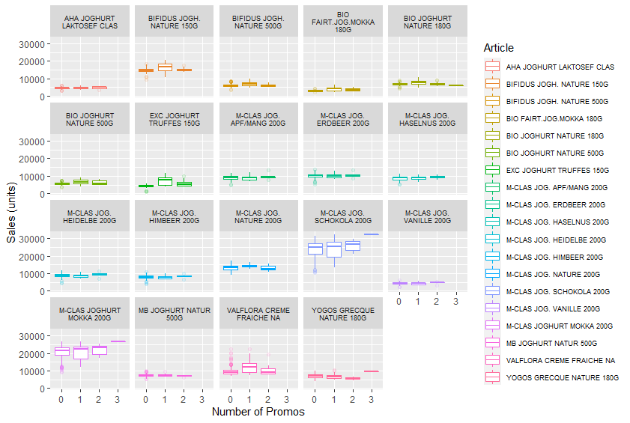
NUMBER OF PROMOS

Slide 54
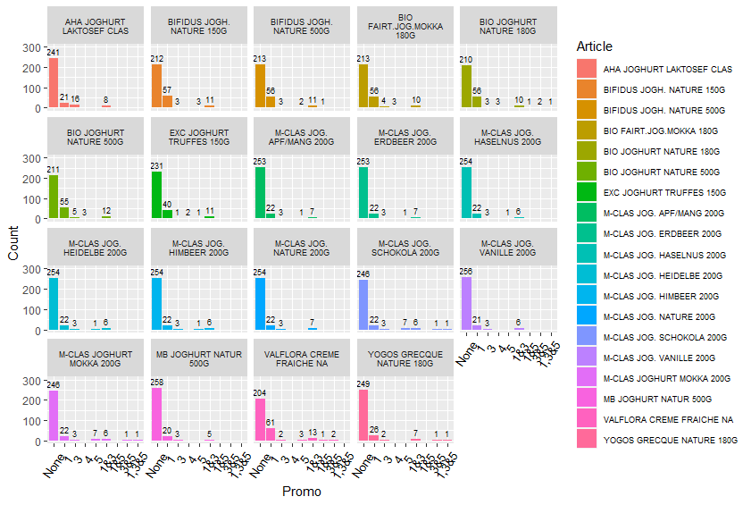
THE PROMOS + NEW VARIABLES
PROMO #2 NEVER APPLIED
Notes:
Dummy variables were added when 2 or more promos were run simultaneously (1&3, 1&5, 3&5, and 1&3&5).
The original promo variables were updated to 0 to avoid duplication. For example in a week where both promo_01 and promo_03 were run, these are replaced with 0s and promo_1_3 marked with a 1.
The intent is to simplify incorporating interactions between promos into the prediction model.

Slide 55
EFFECT OF PROMOS
PROMO #2 NEVER APPLIED
Notes:
Dummy variables were added when 2 or more promos were run simultaneously (1&3, 1&5, 3&5, and 1&3&5).
The original promo variables were updated to 0 to avoid duplication. For example in a week where both promo_01 and promo_03 were run, these are replaced with 0s and promo_1_3 marked with a 1.
The intent is to simplify incorporating interactions between promos into the prediction model.

Slide 56
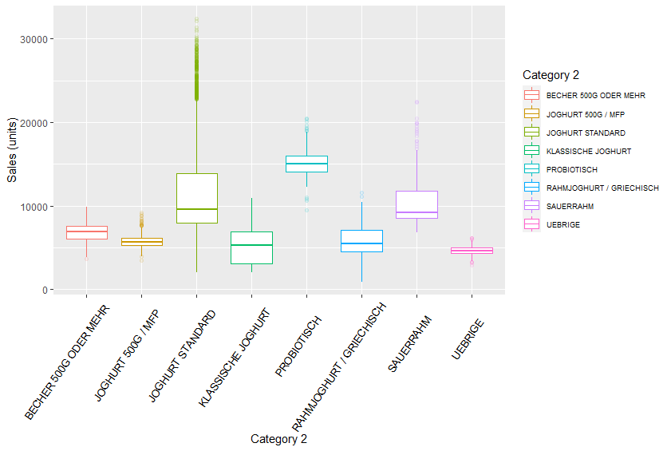
EFFECT OF PROMOS
category_2 | id | article_name
BECHER 500G ODER MEHR | 1 | MB JOGHURT NATUR 500G
BECHER 500G ODER MEHR | 2 | BIFIDUS JOGH. NATURE 500G
JOGHURT 500G / MFP | 6 | BIO JOGHURT NATURE 500G
JOGHURT STANDARD | 10 | M-CLAS JOG. HEIDELBE 200G
JOGHURT STANDARD | 11 | M-CLAS JOG. NATURE 200G
JOGHURT STANDARD | 12 | M-CLAS JOG. HIMBEER 200G
JOGHURT STANDARD | 13 | M-CLAS JOG. SCHOKOLA 200G
JOGHURT STANDARD | 14 | M-CLAS JOGHURT MOKKA 200G
JOGHURT STANDARD | 15 | M-CLAS JOG. APF/MANG 200G
JOGHURT STANDARD | 16 | M-CLAS JOG. ERDBEER 200G
JOGHURT STANDARD | 17 | M-CLAS JOG. VANILLE 200G
JOGHURT STANDARD | 18 | M-CLAS JOG. HASELNUS 200G
KLASSISCHE JOGHURT | 0 | BIO FAIRT.JOG.MOKKA 180G
KLASSISCHE JOGHURT | 3 | BIO JOGHURT NATURE 180G
PROBIOTISCH | 7 | BIFIDUS JOGH. NATURE 150G
RAHMJOGHURT / GRIECHISCH | 4 | EXC JOGHURT TRUFFES 150G
RAHMJOGHURT / GRIECHISCH | 5 | YOGOS GRECQUE NATURE 180G
SAUERRAHM | 8 | VALFLORA CREME FRAICHE NA
UEBRIGE | 9 | AHA JOGHURT LAKTOSEF CLAS

Slide 57
APPENDIX AUTO ARIMA

Slide 58
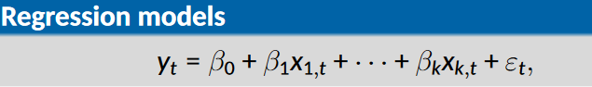
AUTO ARIMA
y_{t} : model as function of k explanatory variables x_{1,t}...x_{k,t}
In regression we assume that ε_{t} is white noise. Now we would like to allow ε_{t} to be autocorrelated, and potentially non-stationary

Slide 59
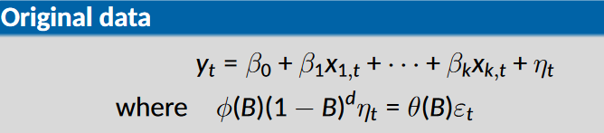
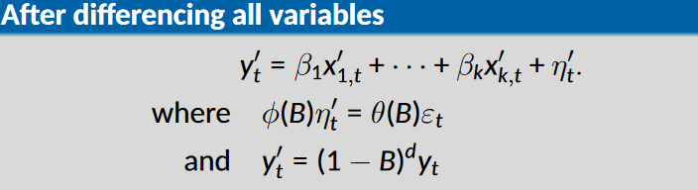
AUTO ARIMA
Any regression with an ARIMA error can be rewritten as a regression with an ARMA error by differencing all variables with the same differencing operator as in the ARIMA model.

Slide 60
AUTO ARIMA
Fit regression model with automatically selected ARIMA errors.
Check that ε_{t} series look like white noise.
Selecting predictors:
AICc can be calculated for the final model
Repeat procedure for all subsets of predictors to be considered and select model with lowest AICc value.

Slide 61
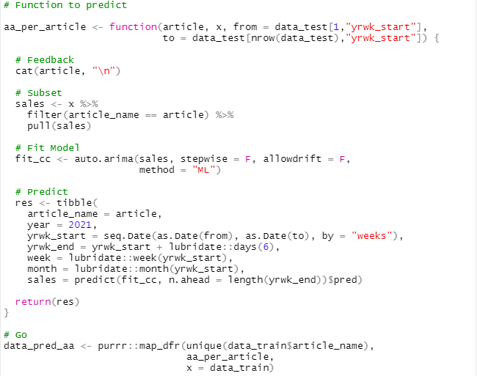
AUTO ARIMA

Slide 62
APPENDIX GAM

Slide 63
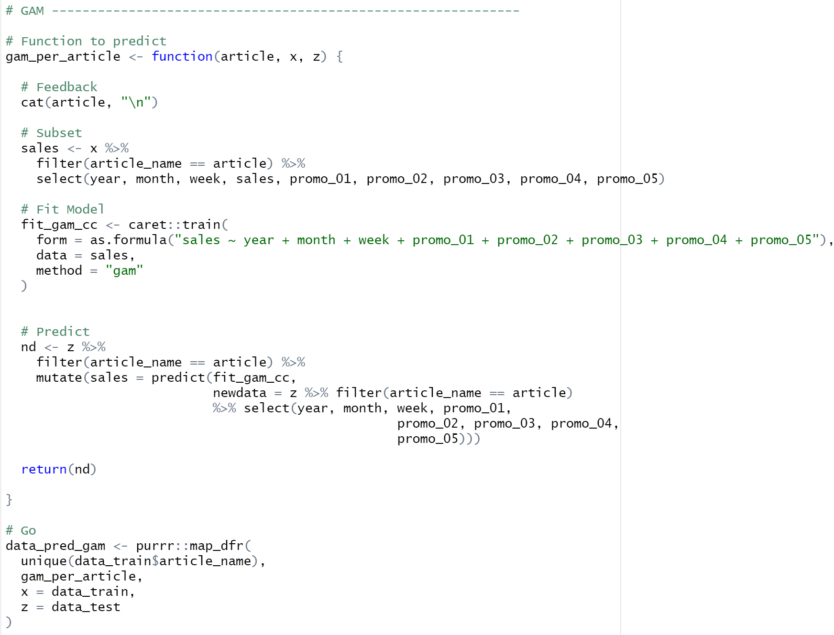

Slide 64
APPENDIX LM

Slide 65
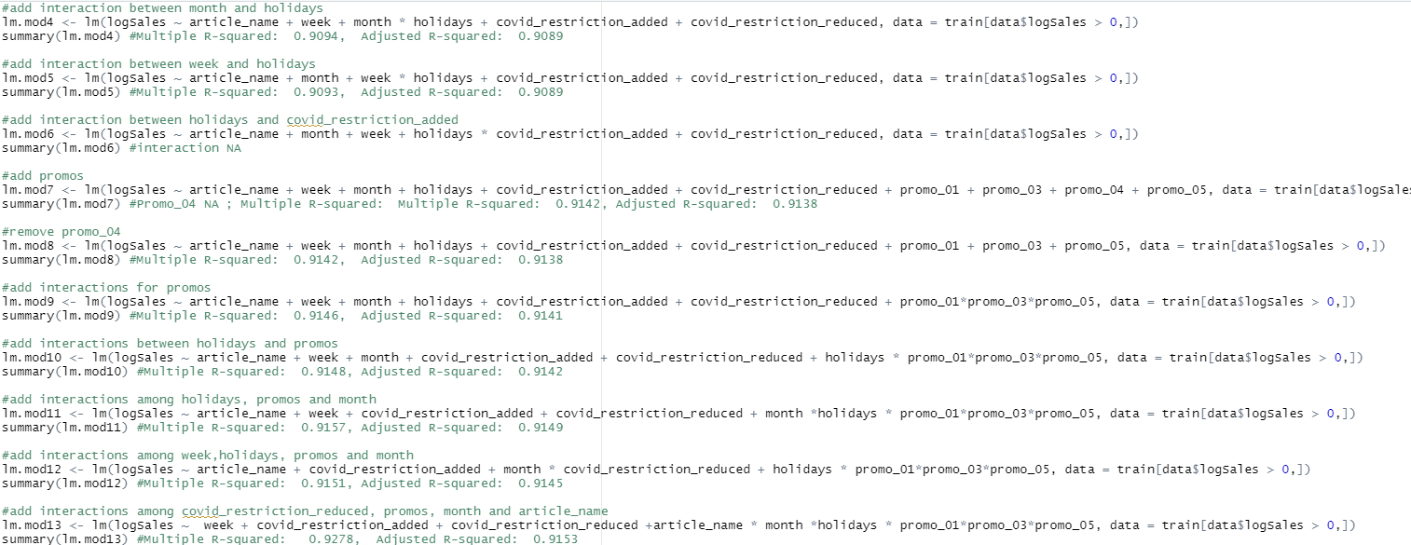
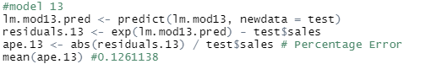
After trying different combinations of variables and interactions…

Slide 66
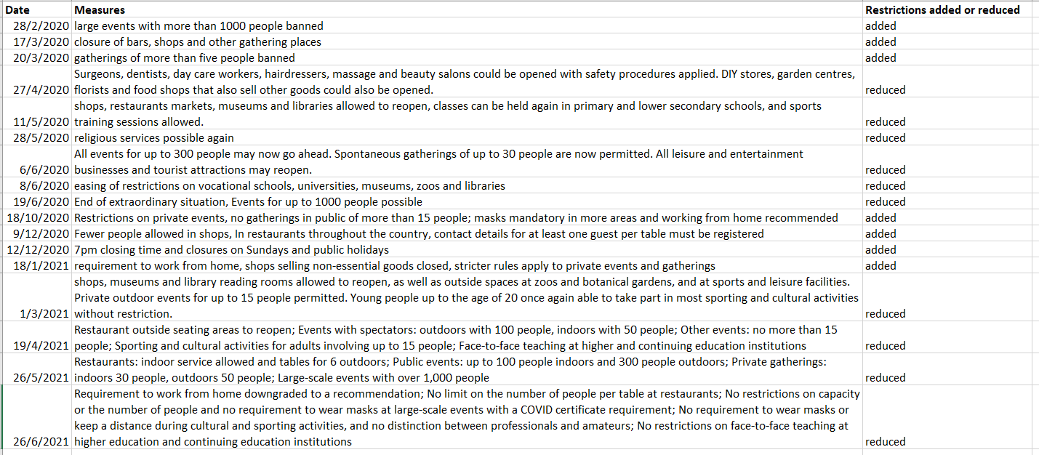
COVID-19 Restrictions Added vs Reduced

Slide 67
APPENDIX COVID

Slide 68
COVID-19 Restrictions Added vs Reduced

Slide 69
No limit at restaurants; No restrictions on capacity or the number of people at large-scale events …
Certain shops and services allowed to open
shops, museums and library reading rooms allowed to reopen
shops, restaurants markets, museums and libraries allowed to reopen
End of extraordinary situation
Events for up to 1000 people possible
Restaurant outside seating areas to reopen
Restaurants: indoor service allowed and tables for 6 outdoors
…
28
Feb
17 Mar
20Mar
27
April
11
May
19
June
18 Oct
12 Dec
18
Jan
1
Mar
19
April
26
May
26
June
2020
2021
large events with more than 1000 people banned
7pm closing time and closures on Sundays and public holidays
closure of bars, shops and other gathering places
No gatherings more than 15 people in public
shops selling non-essential goods closed
gatherings of more than five people banned
Source: https://www.bag.admin.ch/bag/en/home/das-bag/aktuell/medienmitteilungen.html
www.free-powerpoint-templates-design.com

Slide 70
Holiday 2016-2021 (only National holiday was taken into account)
Source: https://www.officeholidays.com/countries/switzerland/zurich/2020

Slide 71
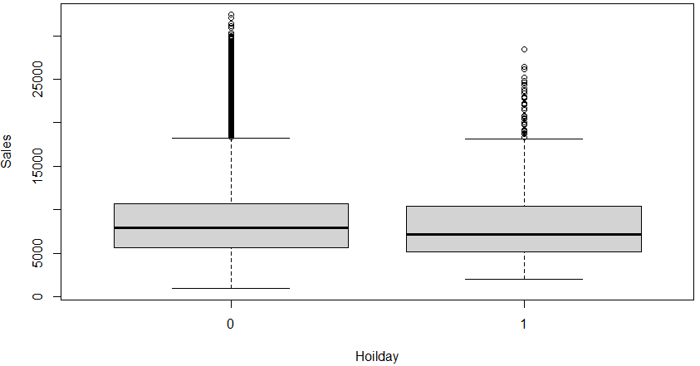
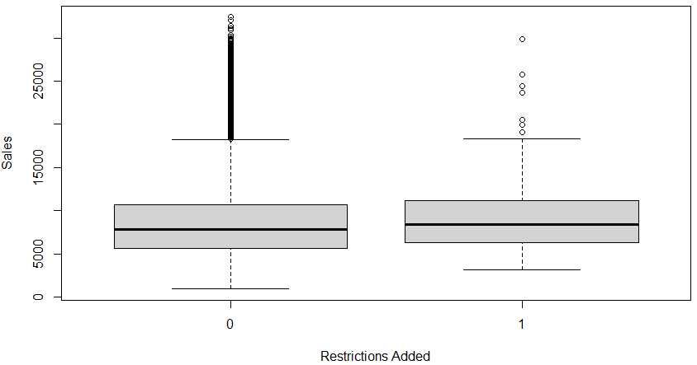
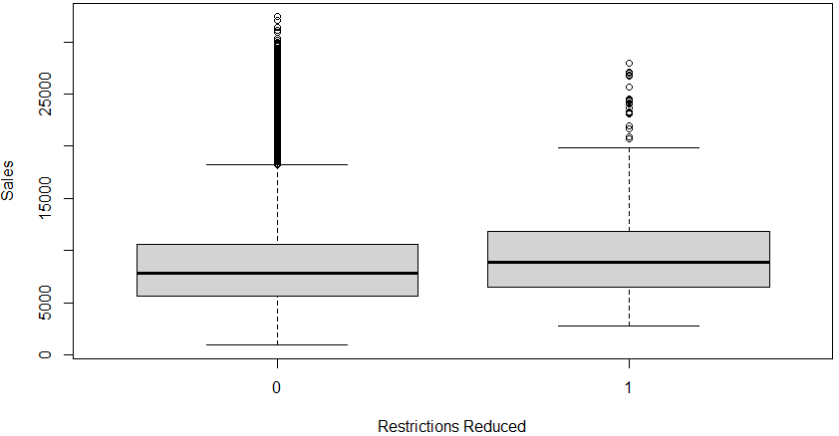

Slide 72
After trying different combinations of variables and interactions…
(train data – before 2021-01-01; test data – from 2021-01-01)
This model has the best result – MAPE 12.61%

Slide 73
Prediction for July-Oct 2021 (using all the data before July as train dataset)

